Slide 1
CTU Headwaters Program
August 2019
Trout in the Classroom
Workshop

Slide 2
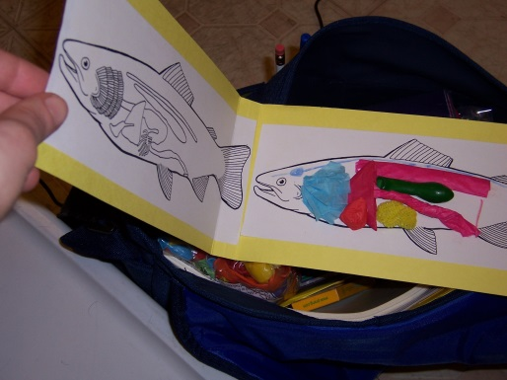
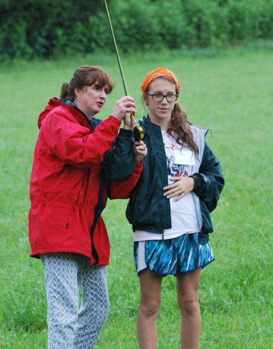
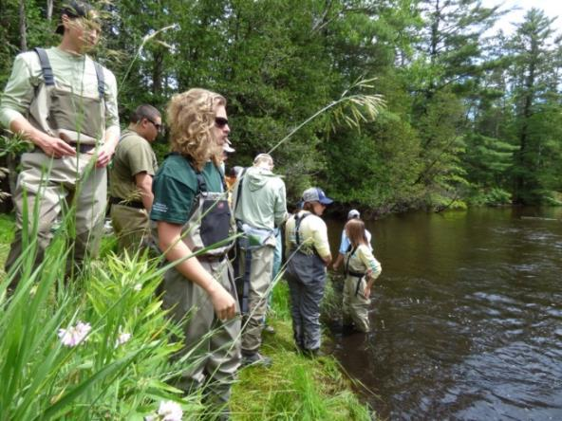
What is STREAM education?
STEM Education in the Watershed
Science
Technology
Engineering
Math
But TU’s approach also includes two other important components…
+ Recreation and + Art =
“STREAM” Education
Notes:
STEM based youth education is one of five strategic opportunities identified in our current strategic plan.
For example, with STREAM Girls, the girls measure turbidity, dissolved oxygen, and pH via sensors and probes, but they are also fishing, tying flies and spending time reflecting through art projects.

Slide 3
TU’s Stream of Engagement
Trout in the Classroom
Adopt-a-Trout
STREAM Girls
Boy Scout Merit Badge
National Fishing in Schools
Stream Explorers
Chapter Programs
Youth Camps
Summer on the Fly
TU Teen Summit
Youth Leadership Council
5 Rivers Clubs
Costa TU 5 Rivers Rally
Native Odyssey
Junior Counselors
Interns
TU member
TU Volunteer
Lifelong Coldwater Conservation Advocate
Parent of a Stream Explorer
Notes:
We’re investing in a stream of engagement such that we create a continuum of programs that introduce youth to fishing and TU and then they are quickly swept up into the current with subsequent programs, activities, and leadership opportunities such that they continue their journeys as anglers and conservationists with TU.
In the last five years, we’ve really worked on insuring the Stream of Engagement has the dots connected between when someone is introduced to TU and adulthood. And, it’s working.
Thanks to the generous contributions of GRTU and others, we’re also growing new programs with high potential to reach many thousands of kids. And, based on the guidance provided through our strategic planning process, as we look forward, our intention is also to really invest in programs that have a STEM learning component for the youth.
The following slides highlight a few of these programs that we’re currently emphasizing, growing and developing over the next four years.

Slide 4
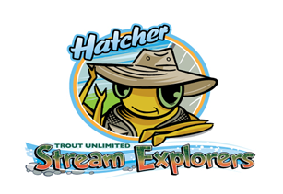
Stream Explorers
Watershed exploration designed for Grades 5-8
Over 4 sessions, participants
Discover the secret lives of creatures that live in the river
Perform aquatic behavior experiments
Gain experience with casting a fly rod and fishing
Learn to tie their own flies
Utilizes inquiry-based learning to change kids from passive observers to active participants
Program connects youth to local rivers and streams

Slide 5
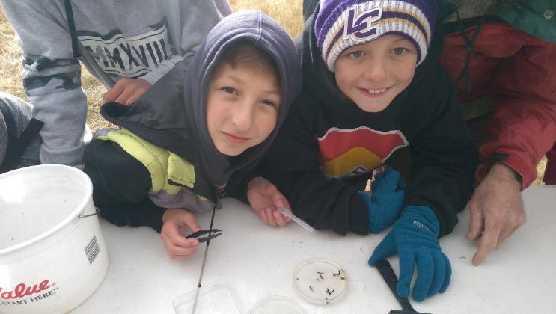
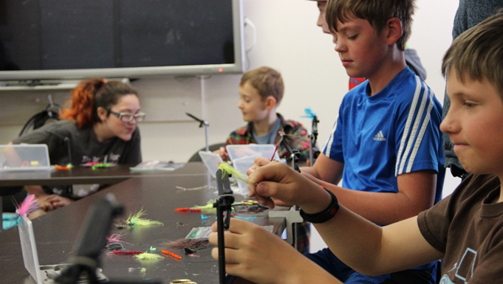
Stream Explorers Activites
River Critters,
Sample invertebrate fauna
Record data and extrapolate
Examine river water jar
Fish and Water Temp Experiment
Observe behavior
Record data, extrapolate
Fly tying instruction
Fly casting and fishing instruction

Slide 6
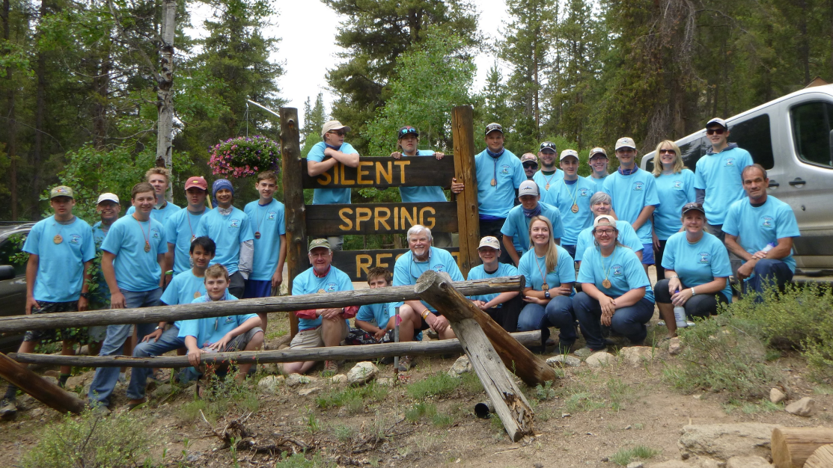
River Conservation and Fly Fishing Camp
Outdoor immersive experience for youth 14-18
8-day overnight camping
Balanced conservation and fly fishing skills education delivered by volunteer staff and invited experts
Exposure to career paths
Campers establish lifelong relationships with peers and mentors

Slide 7
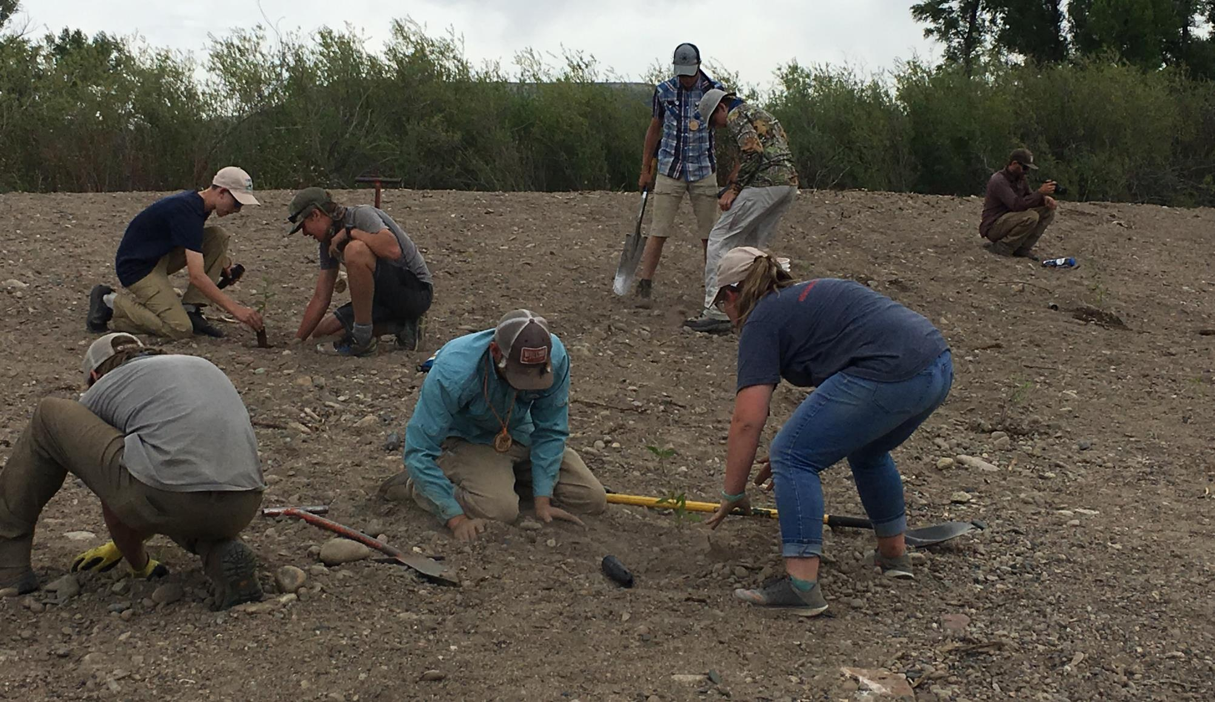
Program Includes:
Entomology and investigation of macroinvertebrates
Water chemistry
Stream morphology and hydrology
Trout biology and pathology
Invasive species
Land trust conservation
Water use and Water Law
Hatchery Tour
Native species restoration
Conservation project
Fly casting instruction
Fly tying instruction
Reading a stream (Angler’s perspective)
Knots and rigs
Fly fishing coaching
Skills games
Journal
Fly Fishing Film Tour

Slide 8
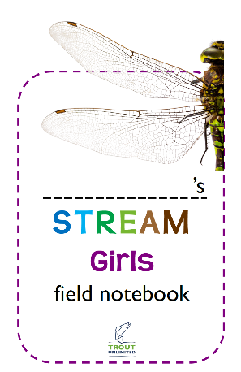
STREAM Girls: A CTU and Girl Scouts of Colorado Collaboration
STREAM Girls is an outdoor watershed experience designed for Cadettes and Juniors including 8 core activities:
A patch program for girl scouts
STREAM Walk
Fly Casting
Go with the Flow!
Macroinvertebrate Survey
Fly Tying
STREAM Scavenger Hunt and Bracelets
Reflection
Discussion

Slide 9
Other Programs That Combine Disciplines to Learn about Watersheds
River Watch
Statewide volunteer water quality-monitoring program
Adopt-A-Trout
radio-telemetry techniques to track and monitor the movements of tagged fish
National Fishing in Schools "Cast A Fly, Catch A Student"
Better understanding and respect for the outdoors through physical activity

Slide 10
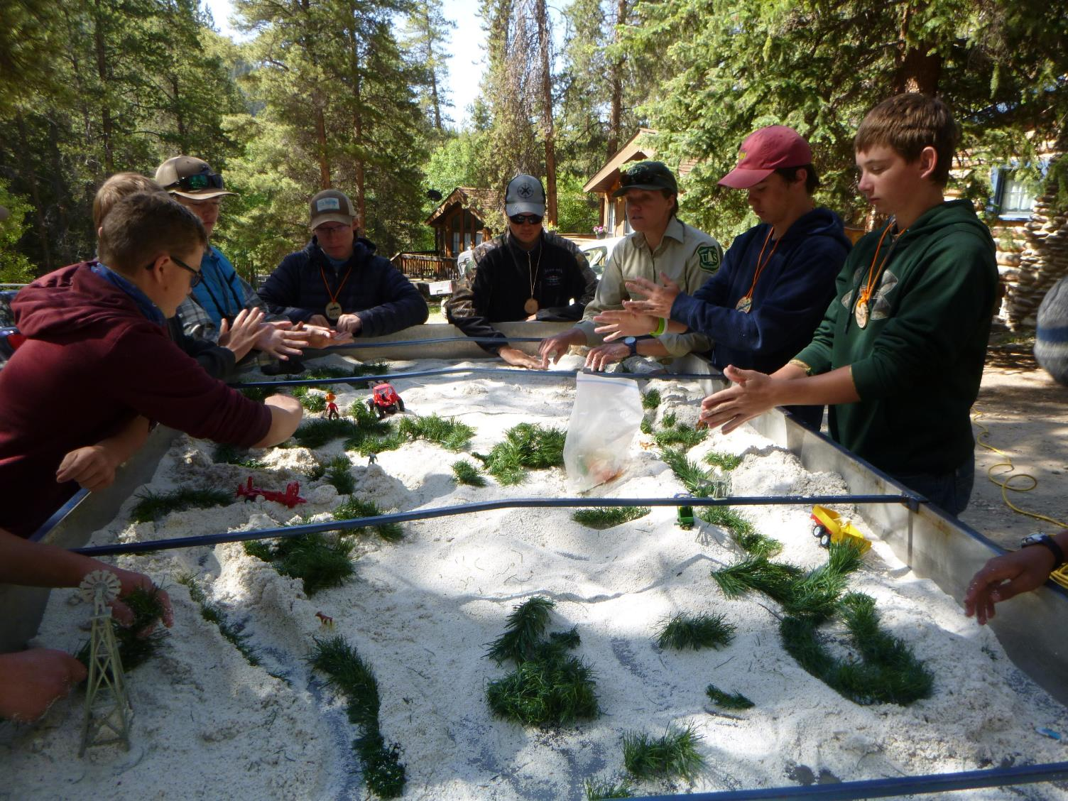
Questions?

