Slide 1
Egg to Fish : Trout Culture 101
Dave Karr
Hatchery Operations Manager
Colorado Parks and Wildlife

Slide 2
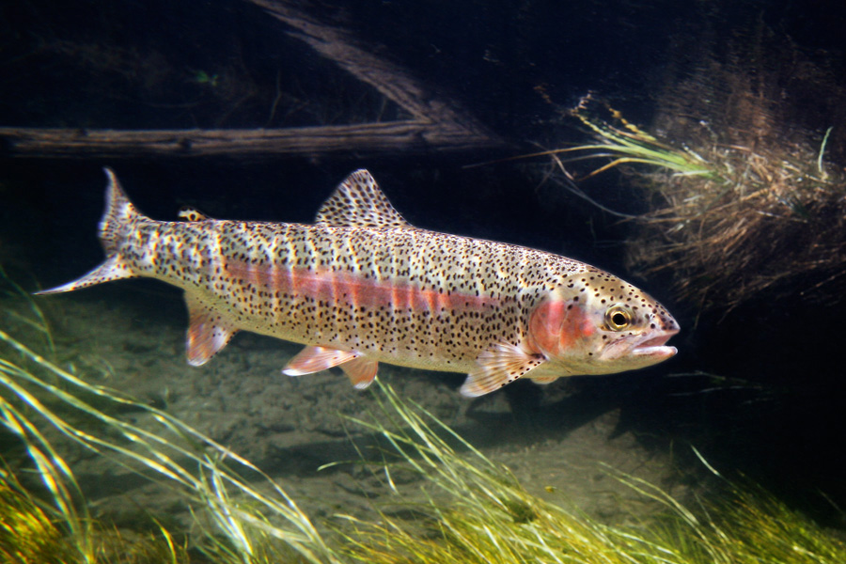
Outline
Basic trout biology
From egg to fish
Environmental maintenance
Colorado hatchery operations
Visiting CPW hatcheries

Slide 3
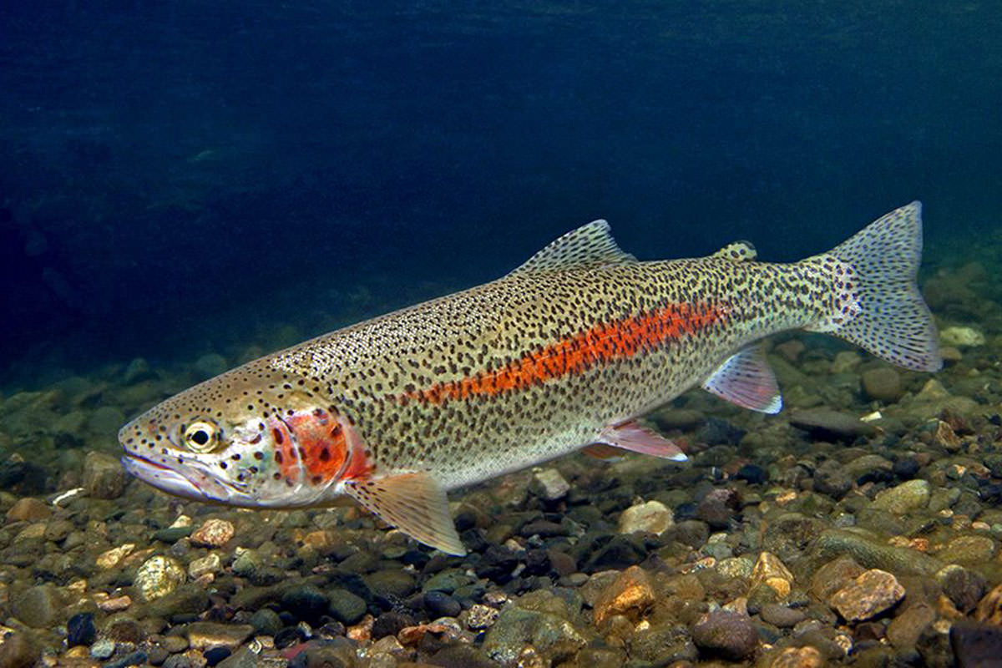
Basic Trout Biology
Members of the salmonid family, which includes trout, char, and salmon
Most species (with the exception of lake trout) adapted to life in rivers and streams
Require running water to successfully reproduce in the wild
Require cool, well oxygenated water (prefer high clarity)

Slide 4
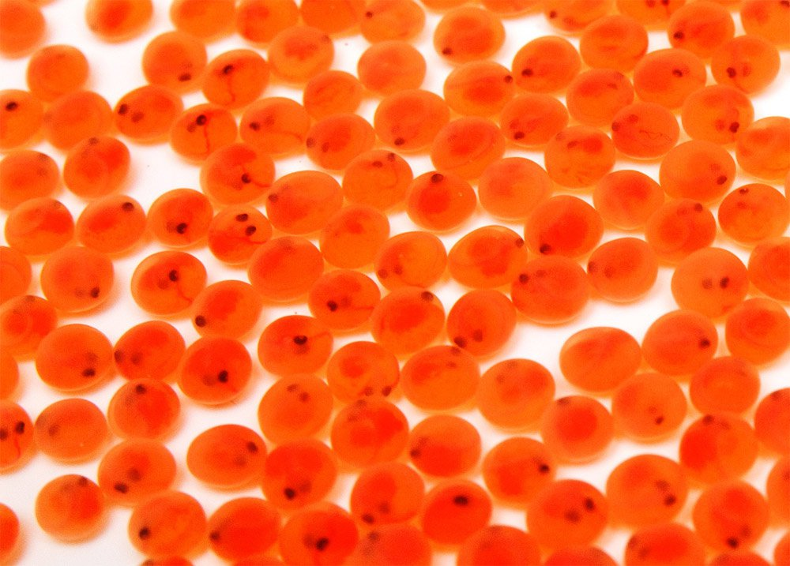
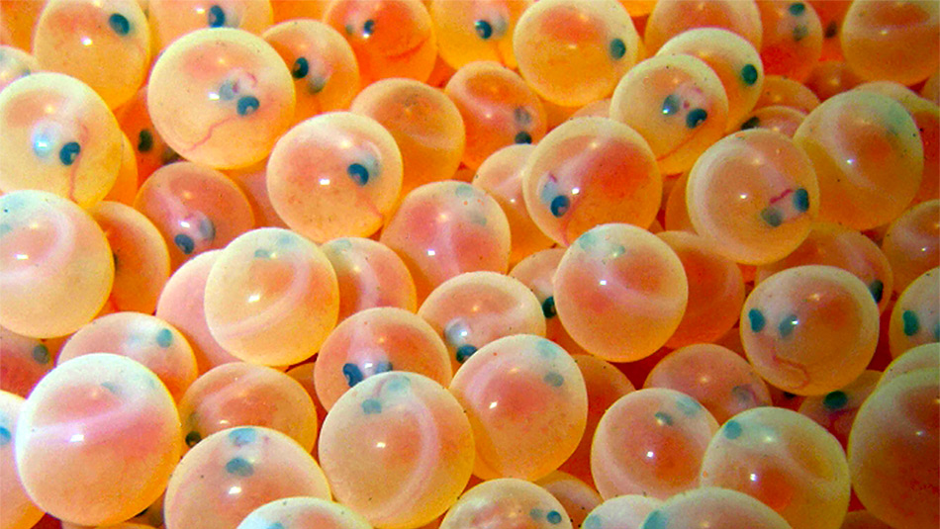
From Egg to Fish
How quickly trout eggs hatch depends primarily on incubation temperature
For rainbow trout, ideally in the high 40 – low 50 degree range
As the eggs approach hatching, the fishes eyes become visible
Eggs you receive will be in the “eyed” stage of development

Slide 5
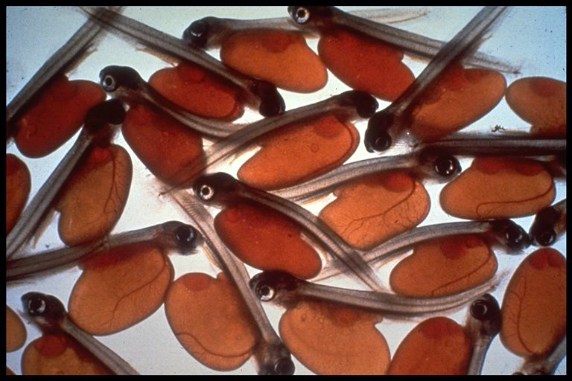
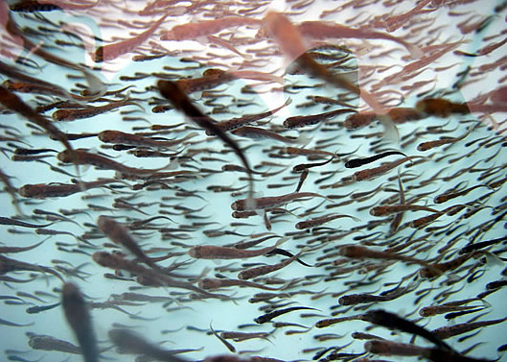
From Egg to Fish, cont.
Newly hatched fish are referred to as sac-fry
Advanced fry have mostly absorbed their yolk sac
generally more active, slightly larger, and darker in color
Once the fishes yolk sac has been completely absorbed, it will “swim-up”
Ready for first feeding!

Slide 6
Environmental Maintenance
Trout are quite sensitive to poor water quality
- High temperature, low DO, high ammonia, high or low pH, heavy levels of suspended solids are all harmful
- Routine cleaning and water changes will help
Proper feeding technique is critical!
- Overfeeding is probably #1 mistake you can make
- Better to give numerous (4 to 6) small feedings throughout the day
Common signs of stress
- Lethargy, piping at surface, refusing feed

Slide 7
Environmental Maintenance, cont.
Some other troubleshooting points
- Avoid direct sunlight (warms water and promotes algae growth)
- Maintain good circulation
- Promptly remove mortalities and wasted food
- Avoid use of bright aquarium lighting
- Try to keep water as cool as possible

Slide 8
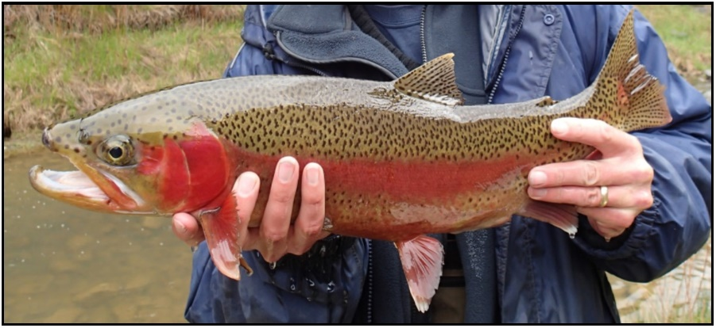
Colorado Hatchery Operations
CPW operates 16 production hatcheries that annually produce close to 100 million fish
In 2018, CPW stocked approx. 2.8 million “catchable” and approx. 93 million “sub-catchable” fish

Slide 9
Colorado Hatchery Operations, cont.
Different hatcheries do different things!
CPW operates dedicated cold water and warm water production facilities, in addition to broodstock facilities
Raise and stock fish year around, even through the ice
Primary challenges at the hatchery level are different
Conserving and protecting water sources
Minimizing fish stress and controlling disease
Manipulating timing of hatching/stocking
Creating and maintaining robust broodstocks

Slide 10
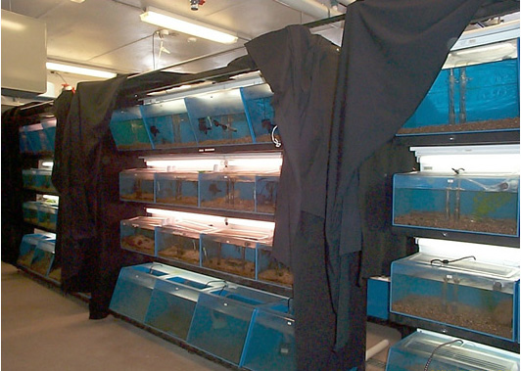
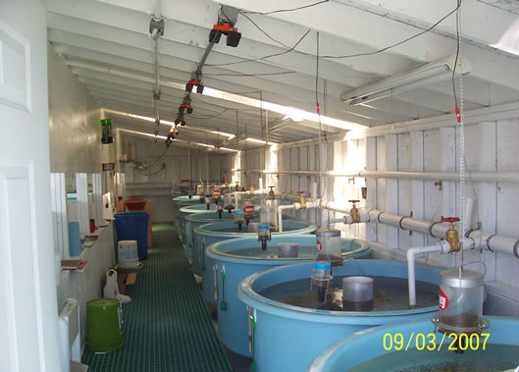
Colorado Hatchery Operations, cont.
Indoor hatchery spaces utilize troughs, circulars, and tanks
Heavily controlled lighting, feeders, and water flow
Protected environment for young fish

Slide 11
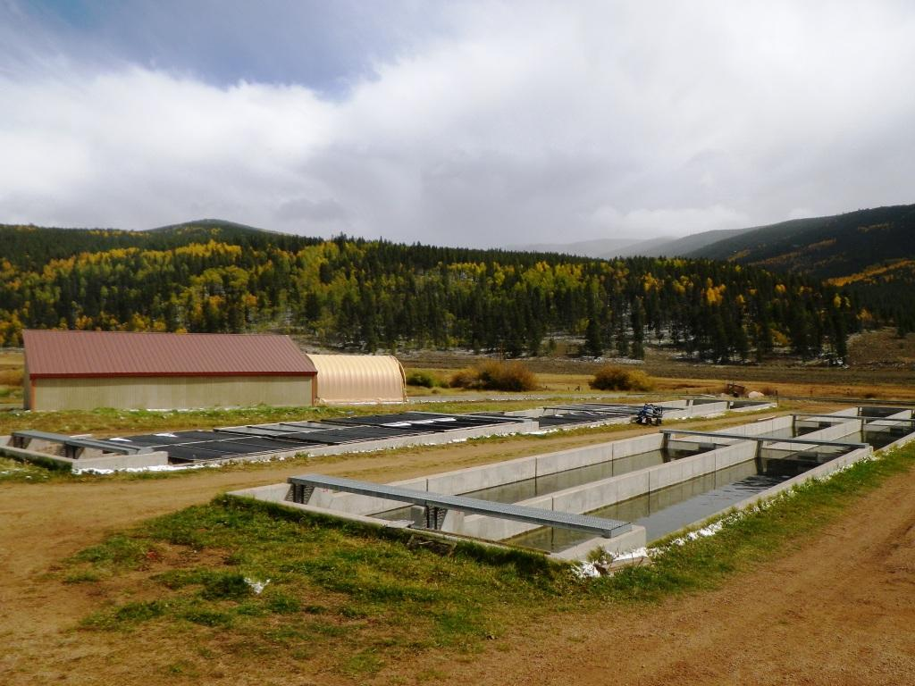
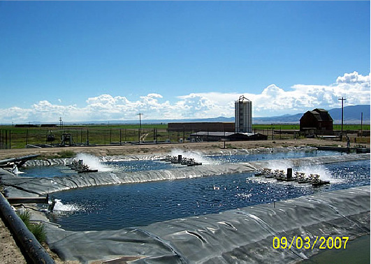
Colorado Hatchery Operations, cont.
Outdoor grow-out options include raceways and ponds
Often utilize some form of aeration
Larger spaces allow fish to reach larger sizes

Slide 12
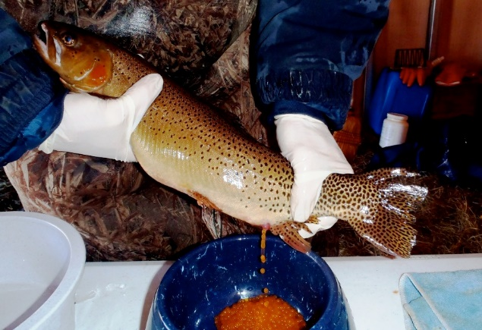
The First Step
Broodstock units provide the eggs
Crystal River, Pitkin, Durango, Poudre River
Spawning operations typically occur in the spring and fall
Production hatcheries also receive eggs from wild broodstocks
Brown trout, walleye
Some procurement from private egg producers and other state wildlife agencies
Troutlodge Inc, tiger musky from Nebraska

Slide 13
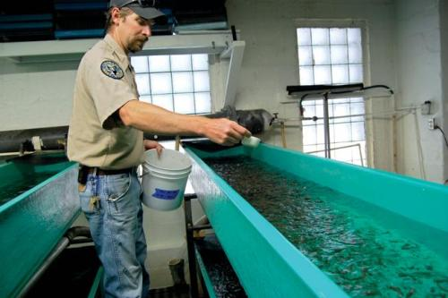
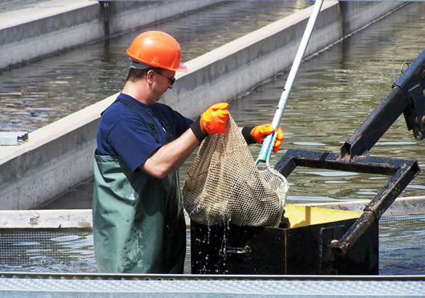
Everything in Between…
We feed them…they grow…we thin them…we feed them…and they grow some more!
Hatchery technicians spend the majority of their time feeding fish, cleaning tanks, and moving fish between holding areas

Slide 14
The Last Step!

Slide 15
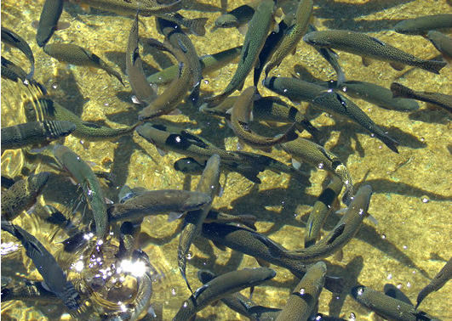
Visiting CPW Hatcheries
Most hatcheries are open to the public for self guided tours
Many hatcheries can schedule a more in-depth tour for larger groups given time to prepare
The Bellvue-Watson, Mt. Shavano, and Pueblo hatcheries would be good choices

Slide 16
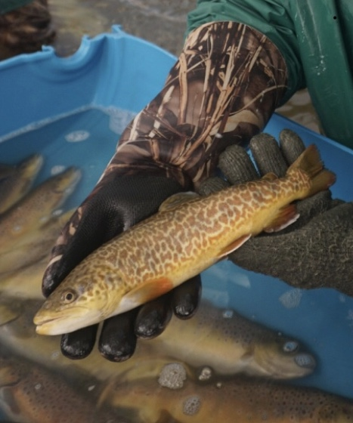
Questions or comments ?

